Slide 1
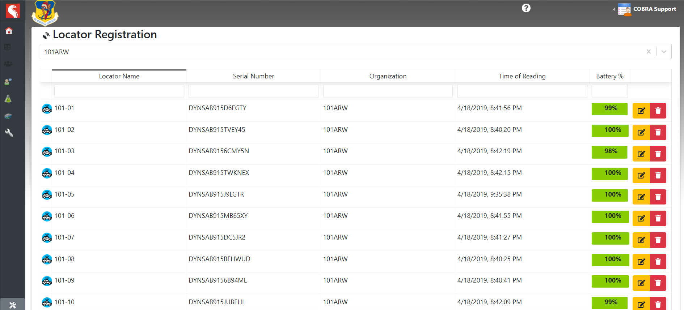
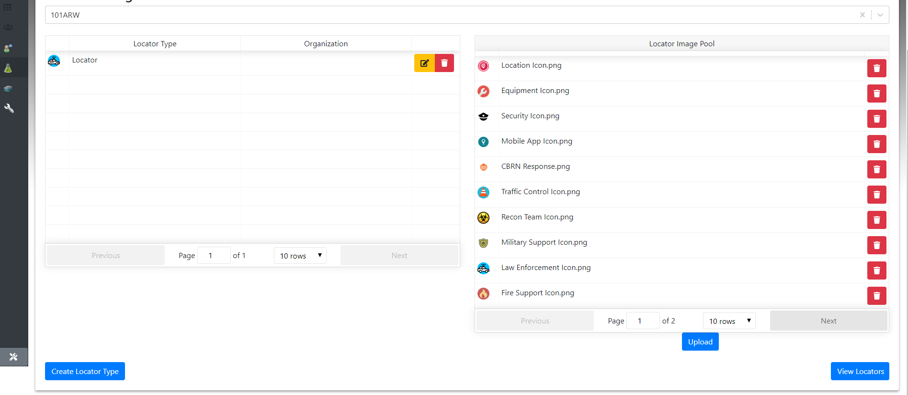
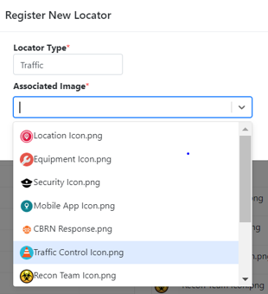
LOCATOR QUICK START GUIDE
Operation
Turn On - 1 second push of button turns on Locator.
GPS light will flash green while obtaining satellite lock.
LTE light will flash red while obtaining cellular connection.
Turn Off - 3 second push of button turns off Locator.
Locator put in a sleep mode which will 'check-in' periodically with COBRA
Send Current Location - Single press of button while on
Immediately sends current location.
All LTE lights green will flash signaling successful transmission
Airplane Mode -3 quick button presses followed by a long press puts the locator in airplane mode. Locations are tracked, but all cellular communications are severed.
All lights will go dark except for 1 white led flash.
Single press returns locator to normal operations.
Shipping Mode - 5 quick button presses followed by a long press puts the locator in shipping mode.
LED will illuminate in sequence.
Clears internal locations memory.
Can only be turned on by connecting to USB power.
No periodic check-ins will occur.
COBRA Locator Indicator Lights
Green GPS Light
Flashes while acquiring a GPS Satellite Lock. Solid green when lock is achieved.
LTE Lights
Denote cellular signal strength. The left-most light will flash red while there is no cellular connection or there is difficulty communicating with the internet. If no lights are illuminated, then there is a very weak cellular signal. When a Locator message is successfully sent, the red LTE light will briefly flash and then return to displaying normal LTE connection status.
Red Power Button
Flashes while plugged in and charging. Solid red when Locator is fully charged.
COBRA Locator Administration.
Active Locators can be managed from COBRA Administration Page, click on Locator Registration
NOTE: Changes to Locator types, names and icons must be made on Administration page before activating Locators in incident
Registered Locator Information is provided
View, Edit, rename type, change Icon by selecting
Click on to view current Locator Types associated with the Organization.
Current Locator Types will be displayed along with additional Locator Icons available for use.
Click on to create a new Locator type and Icon from drop down
Identify Locator Type (Traffic Control) and select desired Locator Image then click save.
Once completed new Locator properties can be edited on main Locator Registration Page

Slide 2
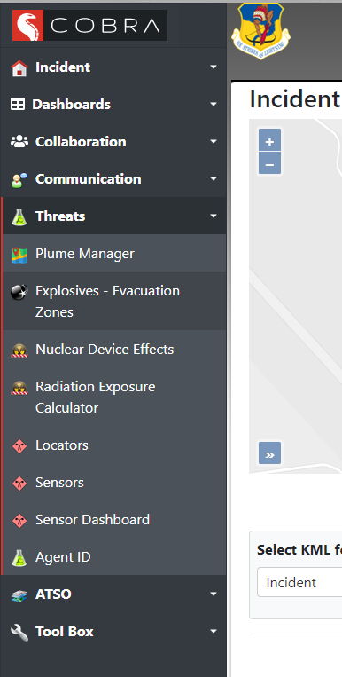
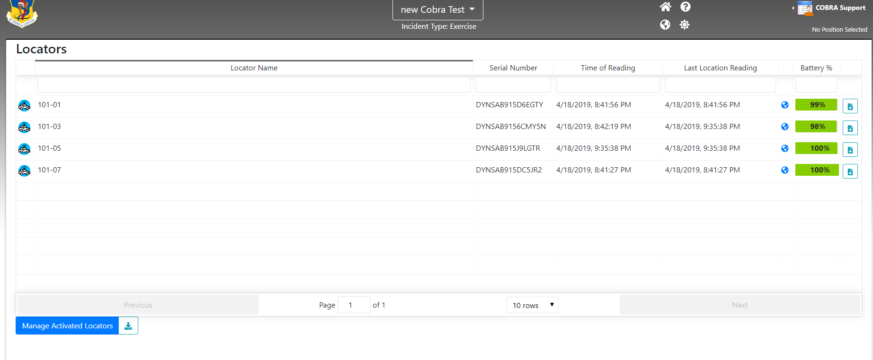
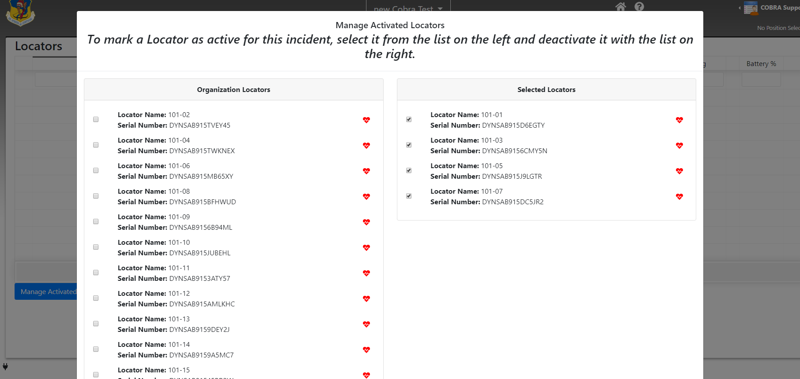
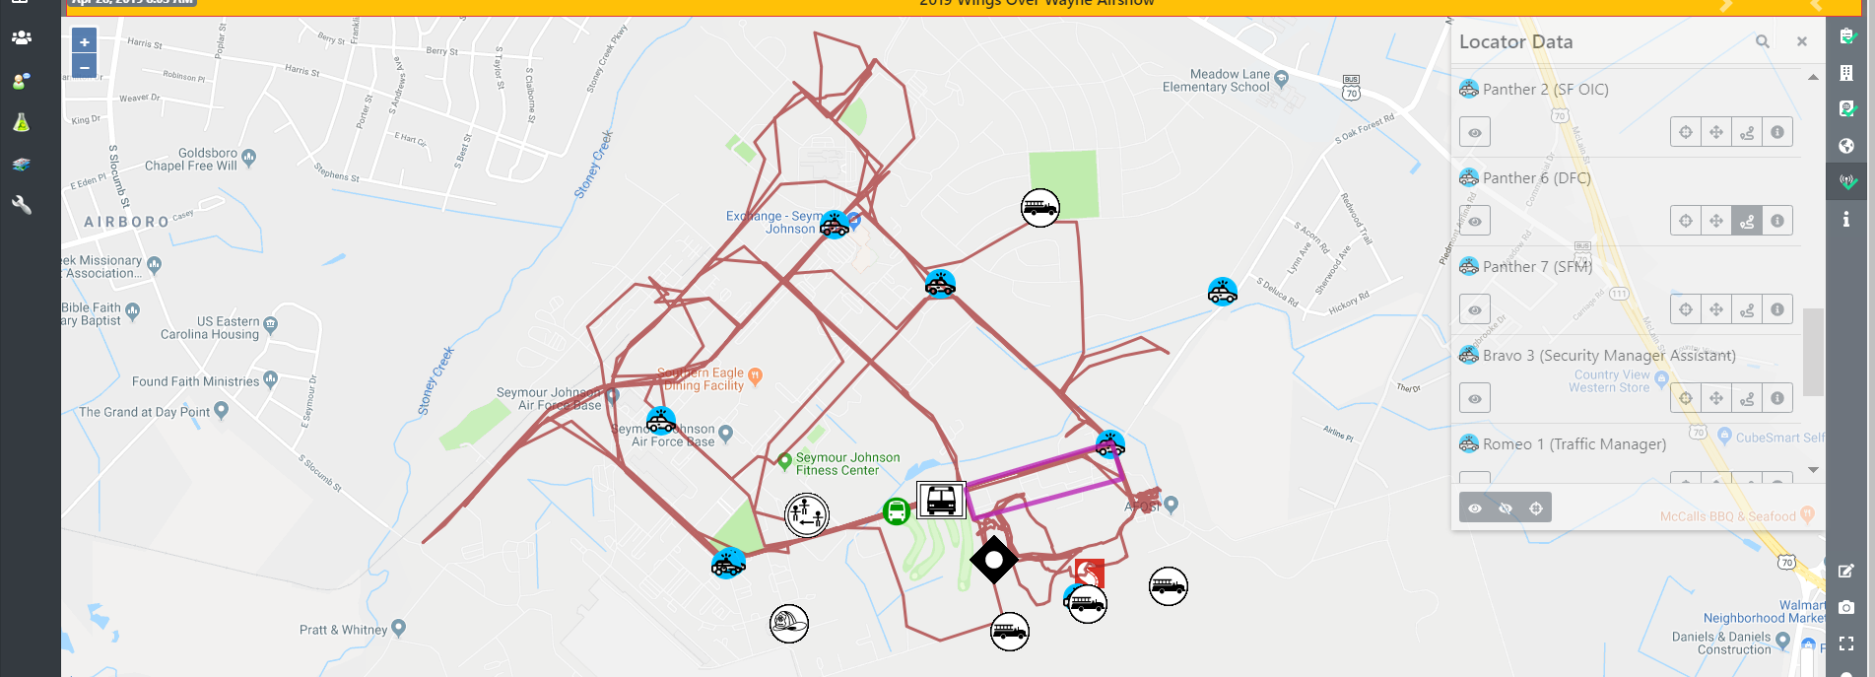
LOCATOR QUICK START GUIDE
Adding COBRA Locators to Incident.
Locators can be added to specific Incidents.
Log on to COBRA and select desired Incident
Once in an active Incident Select Threats then select Locators
If no Locators have been added a prompt will ask if add them
Once Locators are active within the Incident they will appear in the Locators under the Threat Tool. Time of Last Reading, Time of Last Position Read and Battery Level will displayed
Click on the blue globe to immediately view Locator on Map
Locator History can be downloaded for review in other GIS programs
Locators can be viewed on the Map by selecting the Locator Icon on the tool bar. Locators can be turned on/off, Zoom to Location and Toggle Locator History
Locator History will display Locator tracking on the Map for specified Locator (shown below)
A dialogue box will open indicating the Locators that are registered within the Organization. Click on the Locator on the left. to add to the Incident. Click on right Locator to remove from incident

